Slide 1


IMPROVING THE GENERALIZABILITY OF MULTI-CENTER AND MULTI-VENDOR CARDIAC MRI SEGMENTATION MODELS
02 | A | Cyber
202055633 이슬람 살리흐
202155631 케네스 예라슬
202155629 누가예바 알트나이

Slide 2




The Heart – The Human Body’s Powerhouse
Fact 01
Fact 02
Your heart beats around 100,000 times a day – that’s over 35 million times per year!
It pumps about 2,000 gallons of blood daily, fueling every part of your body.
Fact 03
The heart is so strong it works twice as hard as the leg muscles of a sprinter.

Slide 3





What’s Putting Our Hearts at Risk?
Unhealthy Diet
Physical Inactivity
Too much cholesterol in the blood can
cause narrowing of arteries
Raises blood pressure,
cholesterol, and weight.
Smoking
Tobacco damage blood vessels, leading to CVD.
Alcohol
Air Pollution
Raises blood pressure, adds extra calories, & increases the risk of arrhythmias and heart failure
Leads to inflammation and artery damage => increases the risk of heart attacks and strokes

Slide 4


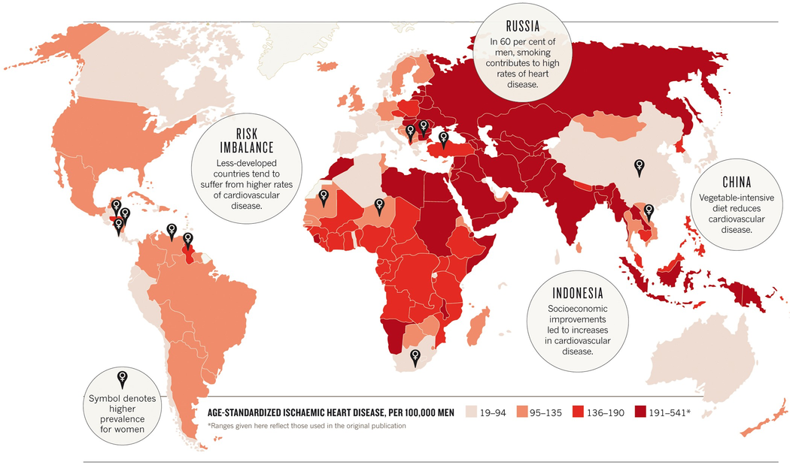
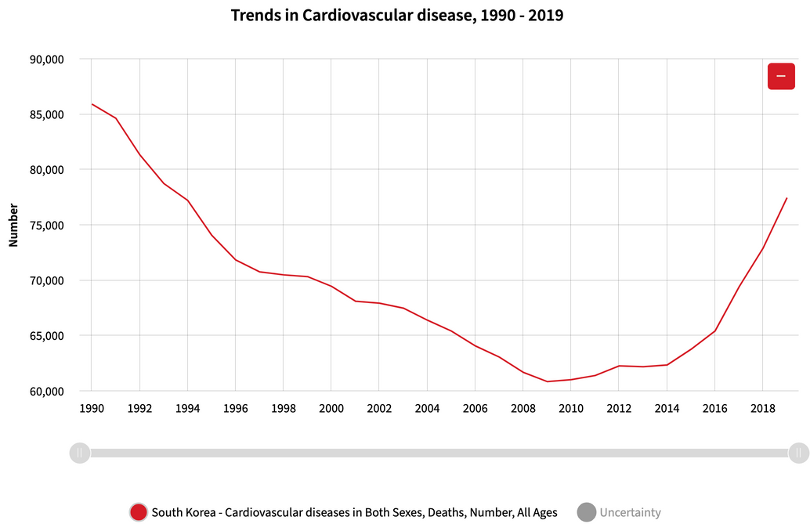
The Rising Threat of
Cardiovascular Diseases
32% of global deaths
are from CVDs
85% of CVD deaths are due to heart attacks and strokes
17.9 million lives lost every year

Slide 5

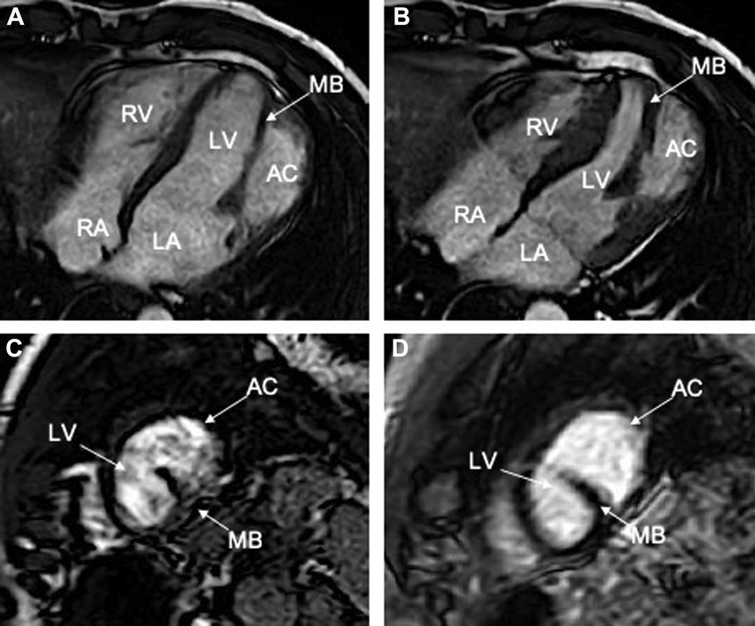
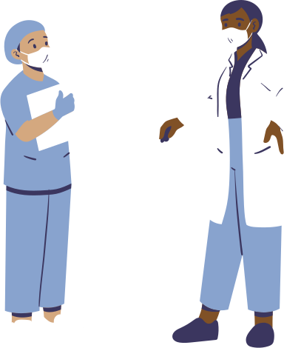
Innovative Solutions
The Power of MRI
Cardiac MRI (cMRI) is the gold standard for diagnosing heart conditions – especially for tracking key areas like the left ventricle, myocardium, and right ventricle.
Manual segmentation takes hours of focus, often leading to inconsistencies. But there’s a game-changer in heart imaging!
Deep learning is transforming cMRI analysis, making it faster, accurate, and more reliable.

Slide 6



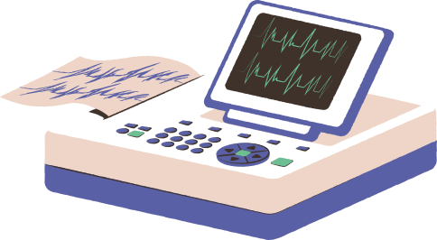


Problem Background
The Future: Robust, Generalized Models for All
Current deep learning models struggle with generalization – why?
Possible reasons:
01
variability in imaging protocols
02
different clinical centers or imaging vendors;
03
scanner-specific biases;
We need models that can handle this variety to ensure accurate diagnoses for everyone, everywhere!

Slide 7




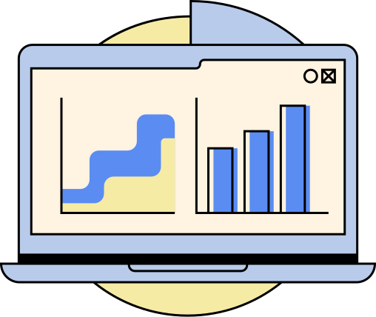




1
Review Segmentation Methods
Evaluate strengths and limitations of existing cardiac MRI segmentation techniques, with a focus on dataset generalization.
Objectives
2
Prepare Diverse Data
Apply normalization and standardization to create a robust, well-prepared dataset for training.
3
Develop & Test New Model
Design a deep learning model optimized for consistent segmentation across varying datasets.
4
Evaluate & Compare Models
Assess model accuracy and generalization using domain adaptation and data augmentation techniques.
5
Enable Clinical Application
Ensure practical model use to improve cardiac imaging workflows in clinical settings.

Slide 8

Dataset
M&Ms-2 Challenge Dataset
results of 360 patients
160 training instances
patients with diseases + healthy patients
40 validation instances
3 different vendors
200 annotated images
9 different scanner models
scanned at 3 clinical centers in Spain

Slide 9
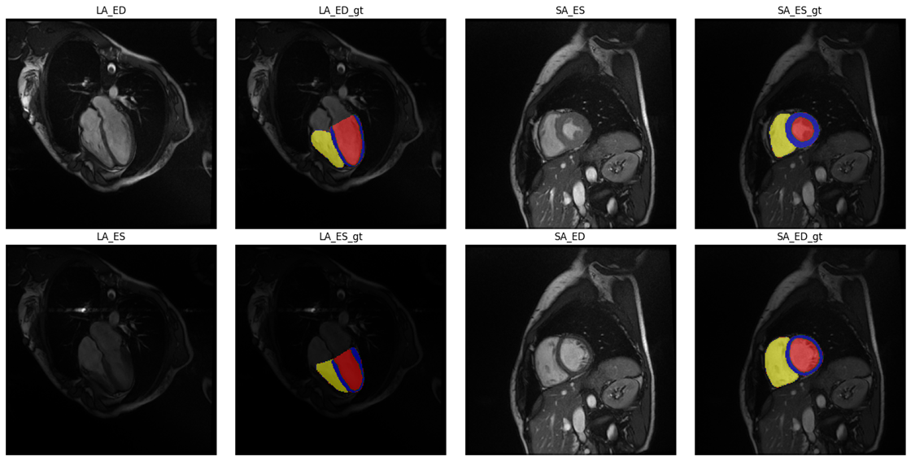
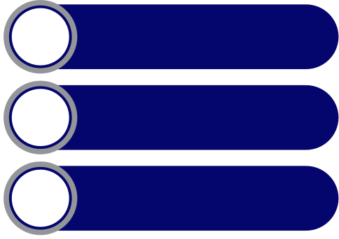


Standard Operating Procedure
for Cardiac MRI Annotation
1
Image Selection
2
Expert Annotation
3
SOP Compliance
Expert manually annotations.
Focused on end-diastolic (ED) & end-systolic (ES) phases in short-axis views, targeting: Left Ventricle (LV), Right Ventricle (RV), Myocardium (MYO).
Followed the ACDC Challenge SOP for uniformity and accuracy across all annotations.
Sample images from dataset representing LA and SA in End-Diastole and End-Systole. Red, Yellow and Blue areas in Ground Truth shows LV, RV, and MYO respectively

Slide 10


Data Preprocessing
to enhance data quality and standardization for accurate deep learning-based segmentation
1.Transposition
Adjusts data to meet model’s input shape requirements.
3.Cropping
Focuses on regions of interest (ROI), covering ~80% of the original volume and tailored to patient-specific data.
2.Voxel Spacing
Rescales images to a consistent target resolution, enhancing feature learning.

Slide 11
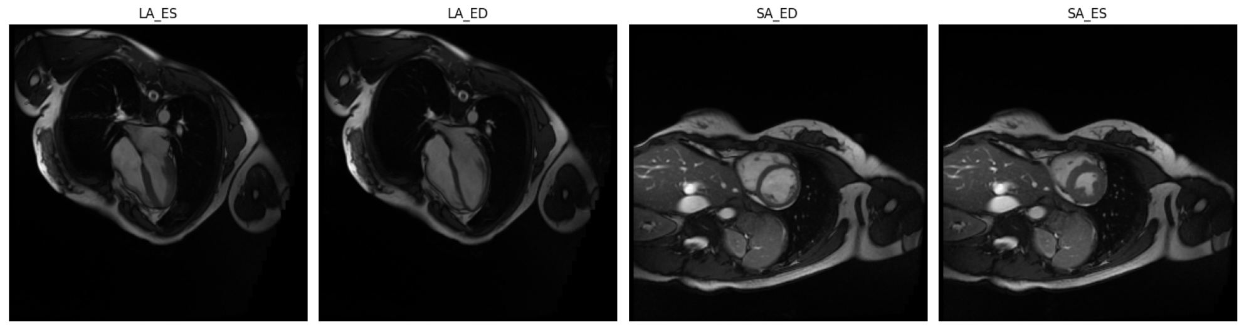
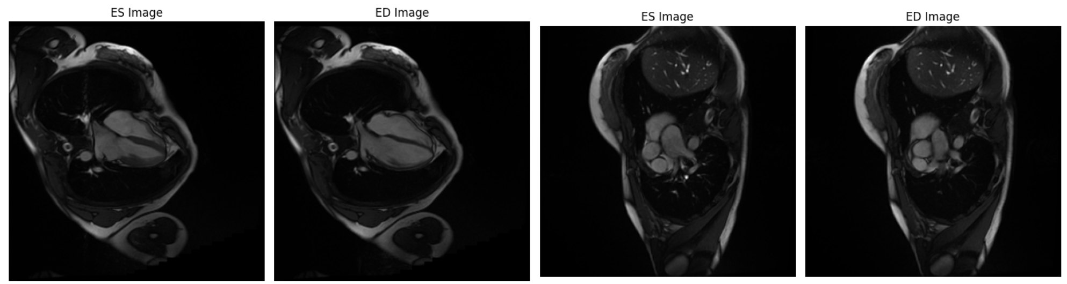
Data Preprocessing
Before
After

Slide 12
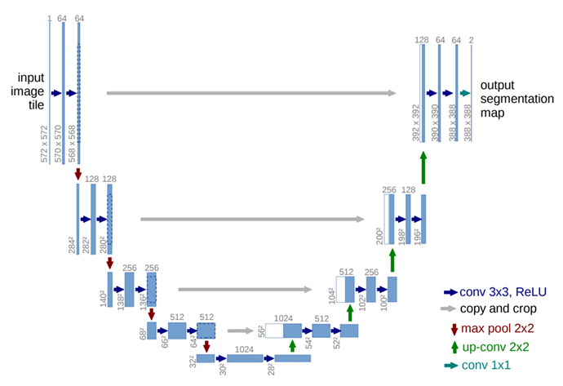
Methodology
Two models are investigated:
Semi-supervised Learning with Quality Control Candidate Selection
U-Net-based Domain Adversarial Neural Network.
Structure: Generic U-Net with encoder for feature extraction and decoder for localization.
Strengths: Captures pixel-level context and performs well with limited data.
Optimizer: Stochastic Gradient Descent (weight decay: 3×10⁻⁵, momentum: 0.99)
Generalizability Test: Excluding Philips vendor data to assess performance on unseen data.

Slide 13
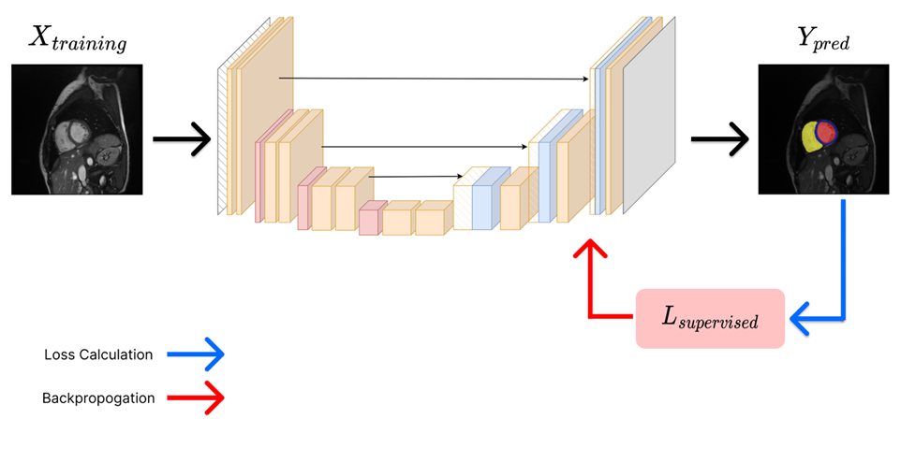
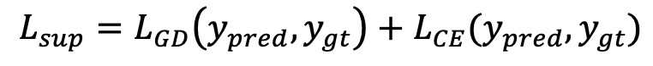
Semi-supervised Learning with
QC Candidate Selection
Combines both labeled and unlabeled data to improve model performance.
Quality Control (QC) Candidate Selection ensures only high quality samples are included for training, enhancing learning efficiency and generalization capabilities.
Supervised Learning
Model: Generic U-Net model.
Loss function: Generalized Dice Loss (L_GD) + Cross-Entropy Loss (L_CE)
Goal: minimize dissimilarity between predicted and ground truth segmentations.
01
Visualization of Supervised learning phase

Slide 14
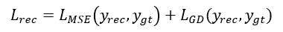
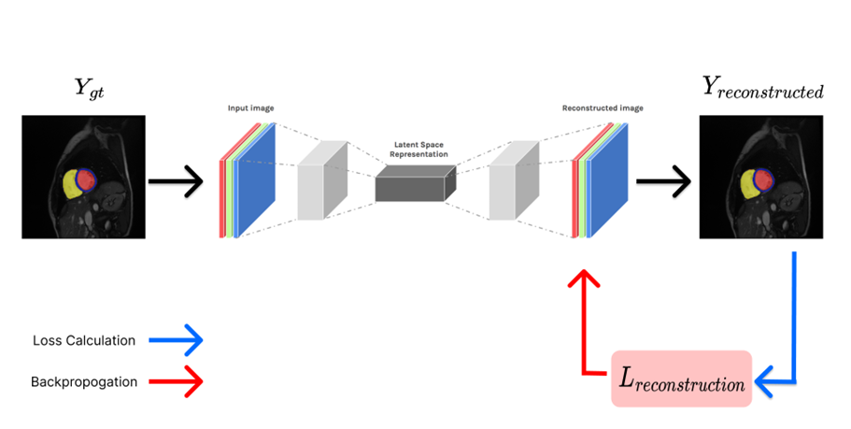
Semi-supervised Learning with
QC Candidate Selection
Learning process: model takes ground truth labels from the training dataset to reconstruct reliable in-distribution labels.
Loss Function: Mean Squared Error (L_MSE) + Generalized Dice Loss (L_GD).
Goal: to compare reconstructed labels (y_rec) with ground truth (y_gt).
QC Feedback: samples with low similarity to predictions are flagged as out-of-distribution (OoD) and used to refine the model through backpropagation.
Convolutional Autoencoder
Design: mirroring the encoder design while replacing convolution with transposed convolutions.
Core idea is to estimate a model that captures the variability in cardiac segmentation masks.
02
Visualization of Reconstruction phase

Slide 15
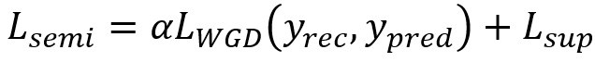
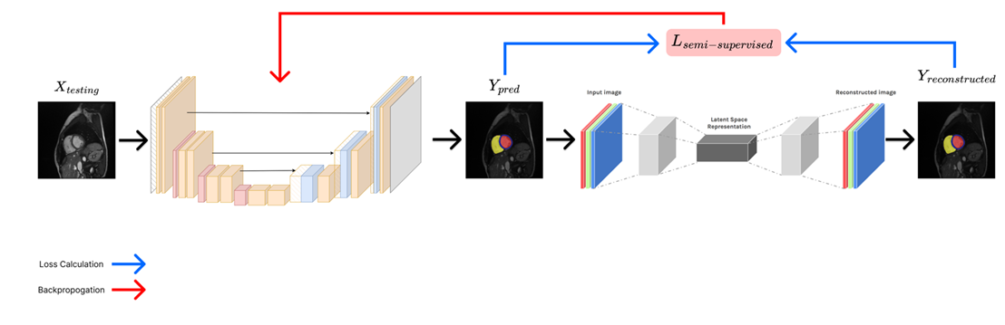
Semi-supervised Learning with
QC Candidate Selection
Semi-supervised Learning
3.a
Combines supervised learning with a reconstruction model to effectively identify out-of-distribution (OoD) data. If OoD data is found, feedback is backpropagated to refine the model.
L_WGD - weighted Generalized Dice Loss
L_sup - supervised loss.
𝛼 adjusts the reliability of the reconstruction model
𝛼 is set to 1/𝑘, where 𝑘 is number of epochs.
Visualization of Semi-supervised Learning phase

Slide 16
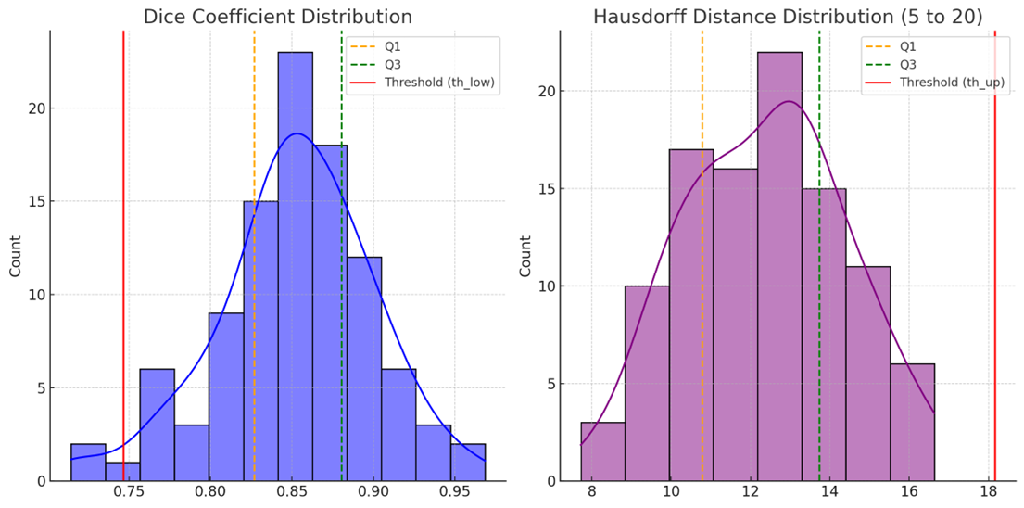
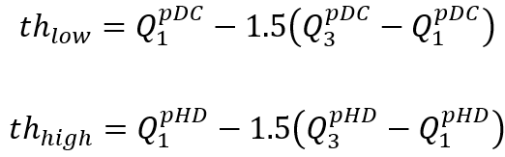
Semi-supervised Learning with QC Candidate Selection
3.b
Semi-supervised Learning
To identify OoD data, pseudo Dice Coefficient (pDC) and pseudo Hausdorff Distance (pHD) are used with defined thresholds.
The best model is selected using Quality Control (QC) based on DC and HD.
pDC and pHD distributions with Upper and Lower thresholds (red line).

Slide 17

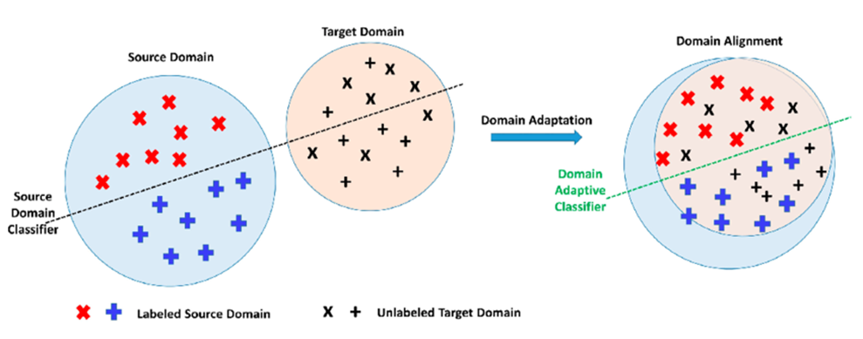
U-Net Based Domain Adversarial
Neural Network (DANN)
Challenges: in cardiac MRI segmentation, variations between vendors, centers, and clinics can drastically impact model performance.
Solution: Domain Adaptation that addresses differences between source (training) and target (testing) datasets.
Methodology: DANN trains the model to segment images accurately & confuse a domain classifier by learning to ignore domain-specific features.
Example of allignment of features after Domain Adaptation

Slide 18
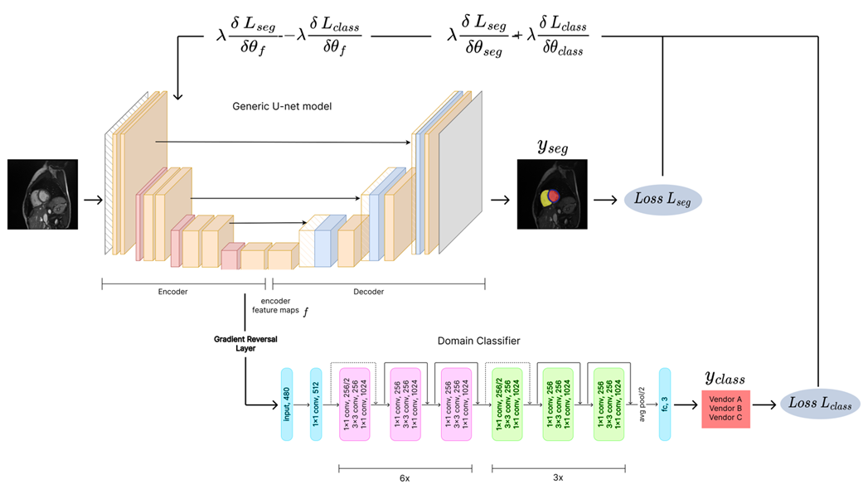

DANN
The U-Net-based DANN consists of three main components: a feature extractor, a main predictor / segmentor, and a domain classifier.
In our setup, the U-Net encoder acts as the feature extractor, and the decoder serves as the segmentor.
Design of U-net based DANN model

Slide 19
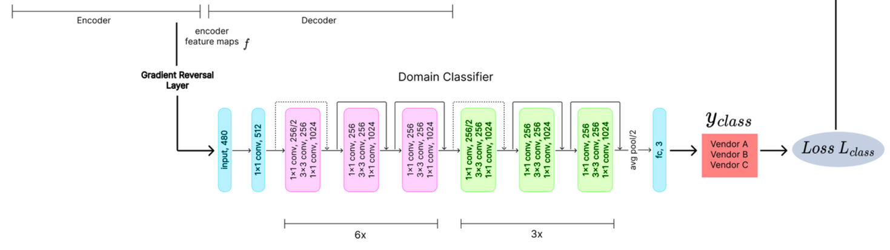

DANN
The Gradient Reversal Layer (GRL) reverses the gradient by multiplying it by -λ,
during backpropagation, encouraging the model to minimize domain differences. Benefits: drives the feature extractor to make the source and target domains indistinguishable, promoting generalization.
Loss function: Generalized Dice Loss (used for segmentation) & Cross-Entropy Loss (used for domain classification). The total loss is defined as:
This combined loss is backpropagated to train the model, ensuring both segmentation accuracy and robust domain adaptation.

Slide 20
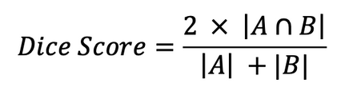
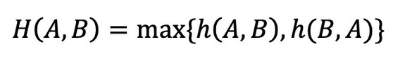
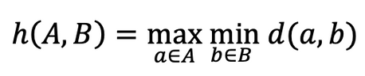
Evaluation Metrics
Dice Score / Dice Coefficient
A statistical measure to evaluate the similarity between two sets (predicted segmentation vs. ground truth).
Range: 0 to 1.
1: Perfect overlap (ideal case).
0: No overlap (poor case).
Balances accuracy by emphasizing both false positives and false negatives, making it a robust metric for assessing segmentation performance.
A - predicted segmentation, B - ground truth
Hausdorff Distance
Measures the degree of mismatch between two sets of points (predicted vs. ground truth boundaries).
Range: 0 to ∞.
0: Perfect alignment (best case).
Captures both worst-case error and the spatial distribution of discrepancies. Provides a comprehensive view of accuracy and robustness in segmentation.
A and B - predicted and GT segmentation boundaries, d(a, b) - distance between points an and b.

Slide 21
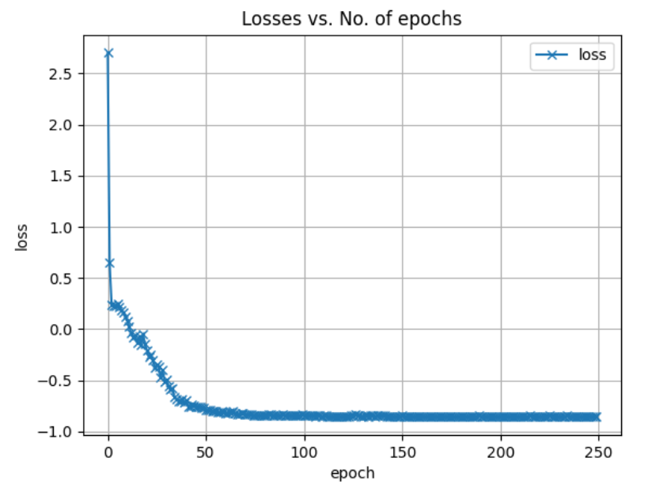
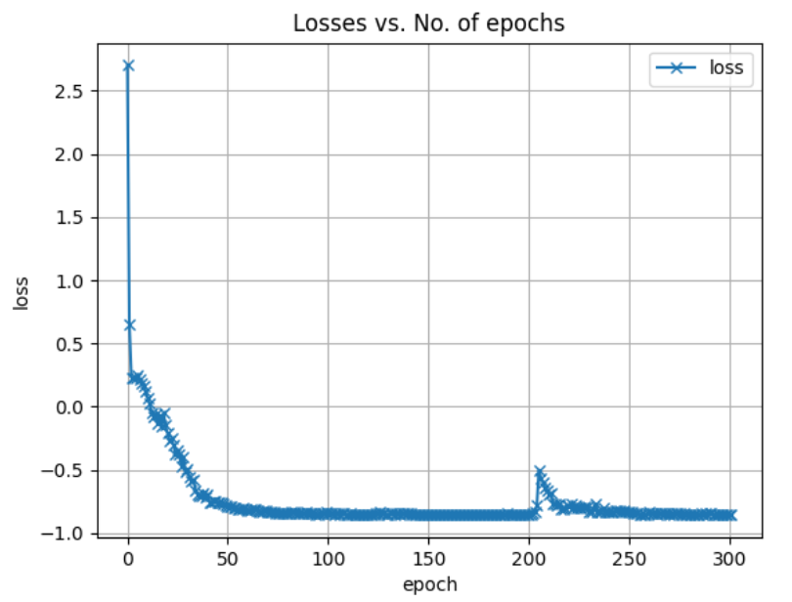
Results for
QC Candidate Selection
Both learning phases shows good convergence around 250-300 epochs.
Supervised learning
Semi-supervised learning
A sharp increase around 200 epochs, which then gently decreased again.
Reconstruction model’s reliability significantly decreased on that period,
and all the OoD data has been investigated.

Slide 22
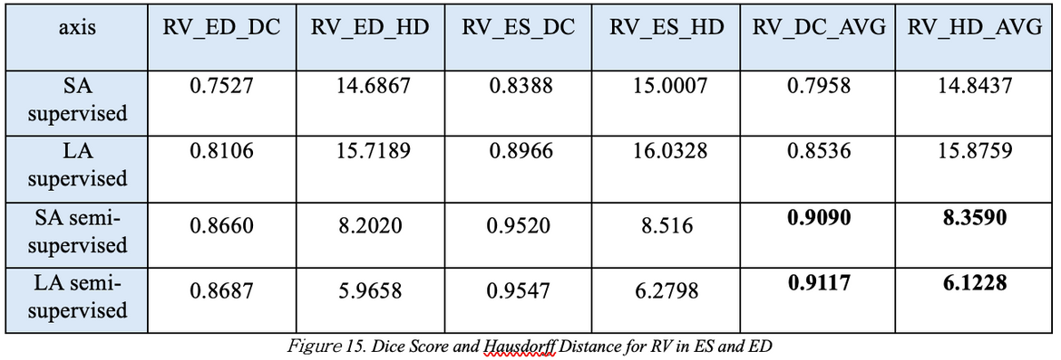
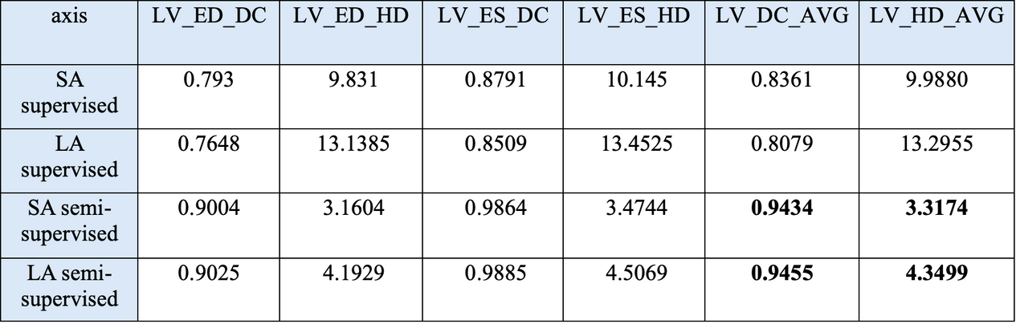

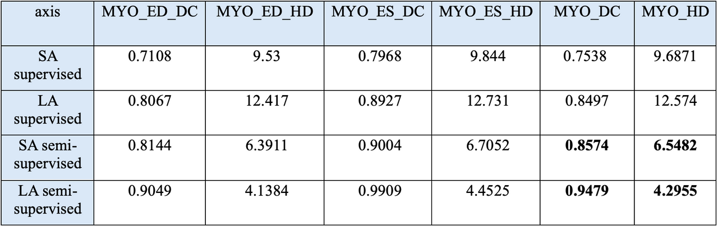
Segmentation Results Comparison
(Semi-Supervised Model)
Right Ventricle (RV)
Short-Axis (SA):
Improved Performance in End-Diastole (ED) and End-Systole (ES).
Long-Axis (LA):
Significant Improvement in generalization; reduced Hausdorff Distance.
Semi-supervised approach enhances RV performance, particularly for challenging LA slices.
Left Ventricle (LV)
Short-Axis (SA):
44% Reduction in Hausdorff Distance
Increased Dice Coefficient for both ED and ES.
Long-Axis (LA):
3% Performance Increase with slight improvements in Dice and Hausdorff.
Substantial gains in SA view; moderate yet consistent improvements in LA view.
Myocardium (MYO)
Hausdorff Distance:
SA: Reduced from 7.6871 to 6.5482.
LA: Sharp drop from 10.574 to 4.2955.
Dice Coefficient:
LA: 10.6% increase, enhancing overall performance.
Noteworthy improvement in LA view for MYO, with enhanced Dice score and marked Hausdorff reduction.

Slide 23
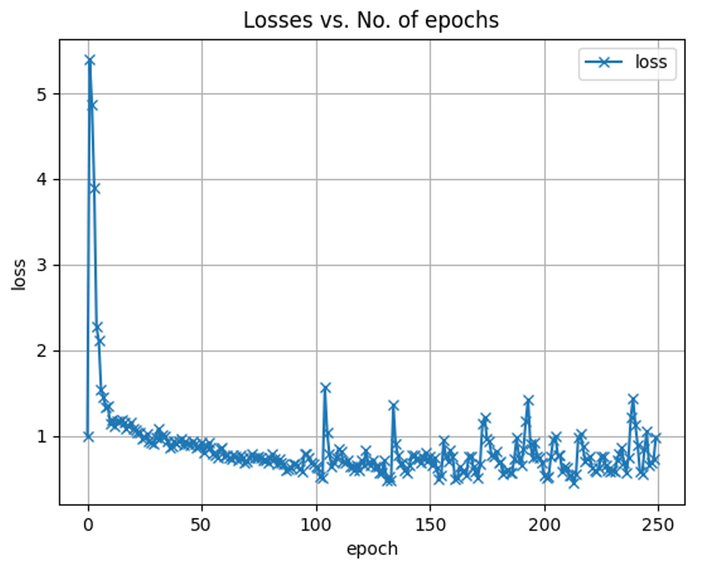
RESULTS FOR
U-NET BASED DANN
Overall Trend
The loss shows a generally positive tendency,
but the model did not fully converge by the end.
Cause of Fluctuations
Likely due to an imbalanced dataset across vendors.
Siemens accounts for over 60% of the data, leading to an uneven class distribution for the domain classifier.
⇒ Imbalance in the dataset could have contributed
to the instability in loss function during training.

Slide 24
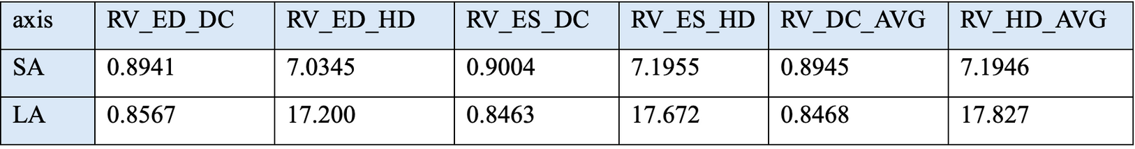
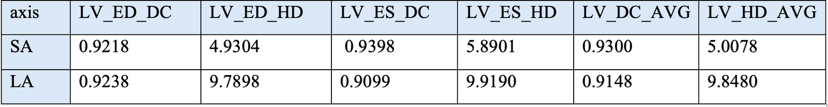
Segmentation Results Comparison
(DANN Model)
Right Ventricle (RV)
Short-Axis (SA):
Dice Scores: 0.8941 (ED), 0.9004 (ES) — Strong overlap with ground truth.
Hausdorff Distance: 7.03 mm (ED), 7.19 mm (ES) — Moderate boundary alignment.
Long-Axis (LA):
Dice Scores: 0.8567 (ED), 0.8463 (ES) — Lower overlap accuracy.
Hausdorff Distance: 17.20 mm (ED), 17.67 mm (ES) — Higher values indicate alignment challenges.
SA view shows stronger overlap, while LA has reduced accuracy and boundary precision.
Left Ventricle (LV)
Short-Axis (SA):
Dice Scores: 0.9218 (ED), 0.9398 (ES) — Excellent overlap accuracy.
Hausdorff Distance: 4.93 mm (ED), 5.89 mm (ES) — Strong boundary precision.
Long-Axis (LA):
Dice Scores: 0.9238 (ED), 0.9099 (ES) — High overlap.
Hausdorff Distance: 9.79 mm (ED), 9.91 mm (ES) — Indicates boundary precision can improve.
SA demonstrates excellent overlap and boundary accuracy; LA maintains high overlap but could improve in boundary alignment.

Slide 25
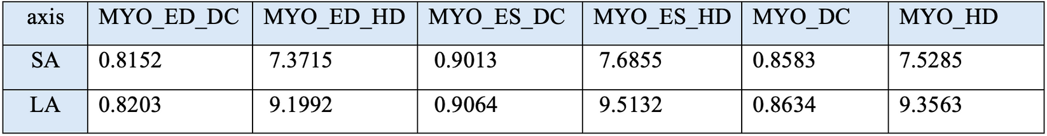
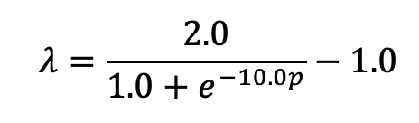
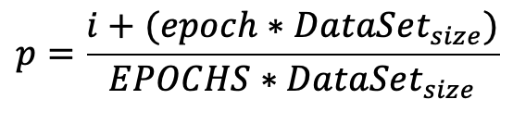
Segmentation Results Comparison
for Myocardium (MYO)
Myocardium (MYO)
Short-Axis (SA):
Dice Scores: 0.8478 (ED), 0.8645 (ES) — Reasonable overlap.
Hausdorff Distance: 7.42 mm (ED), 7.61 mm (ES) — Moderate boundary precision.
Long-Axis (LA):
Challenges: Initially low Dice scores and high Hausdorff Distances due to a static Gradient Reversal Layer (GRL) coefficient.
Solution: Dynamic GRL coefficient adjustment:
Early training: Lower coefficient, focus on classification.
Later training: Increasing coefficient for domain adaptation.
Dynamic GRL significantly improved MYO Dice Score and Hausdorff Distance.
epoch - current epoch, i - current iteration,
EPOCHS - the number of epochs overall (250),
DataSet_size - the size of the data set

Slide 26
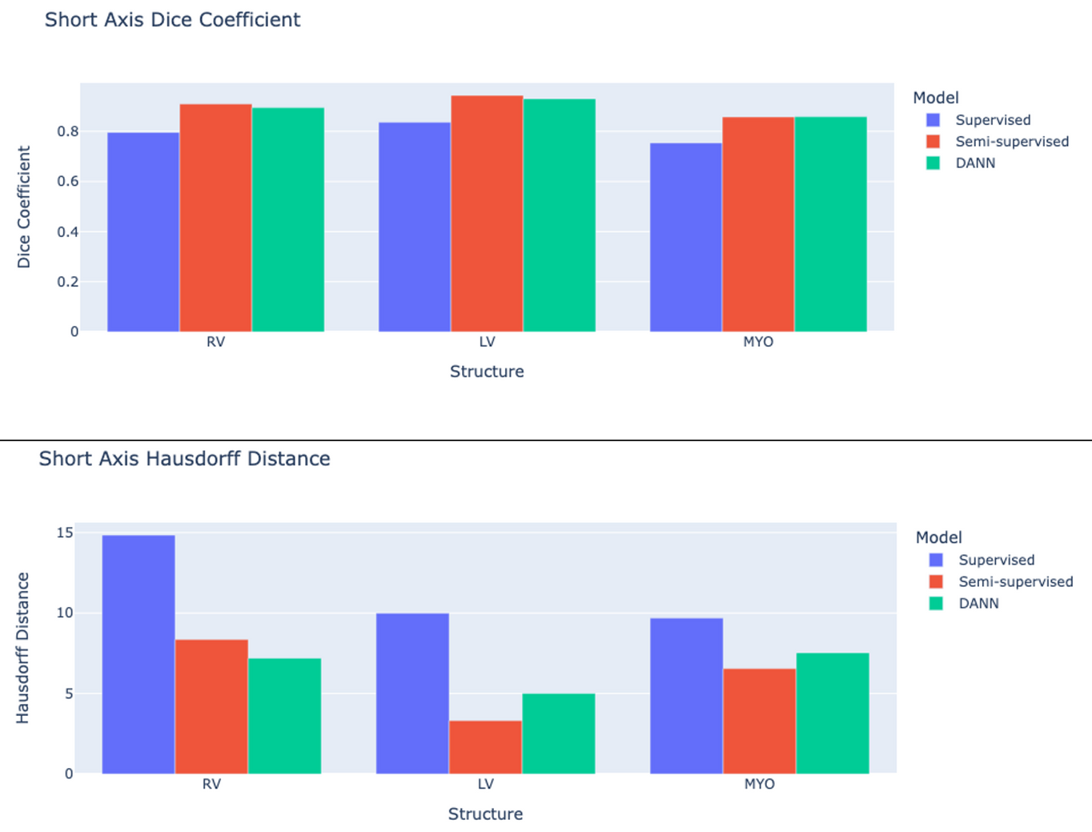
Comparison of Models (SA)
Plot 1:
Semi-supervised and DANN models show similar results across RV, LV, and MYO.
Plot 2:
DANN model performs best on RV.
Semi-supervised model shows outstanding performance on LV and MYO.
Supervised model consistently shows slightly worse results across all structures.
⇒ Semi-supervised model excels on LV and MYO, while DANN performs better on RV, making both models better than supervised learning.

Slide 27
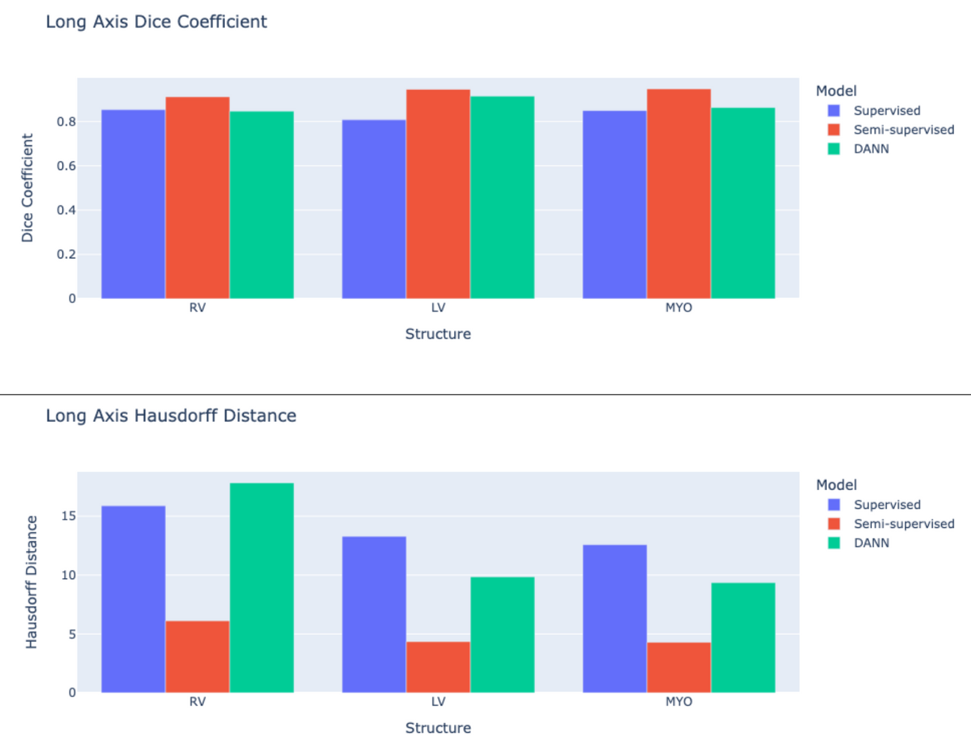
Comparison of Models (LA)
Semi-supervised Model:
Consistently outperforms both DANN and Supervised models in Right Ventricle (RV) and Left Ventricle (LV) segmentation.
Achieves higher Dice Coefficient and lower Hausdorff Distance, indicating superior segmentation accuracy.
⇒ The Semi-supervised model demonstrates the best overall performance for both
RV and LV structures.

Slide 28

PRODUCTION DEPLOYMENT
MRI SEGMENTATION WEBSITE

Slide 29
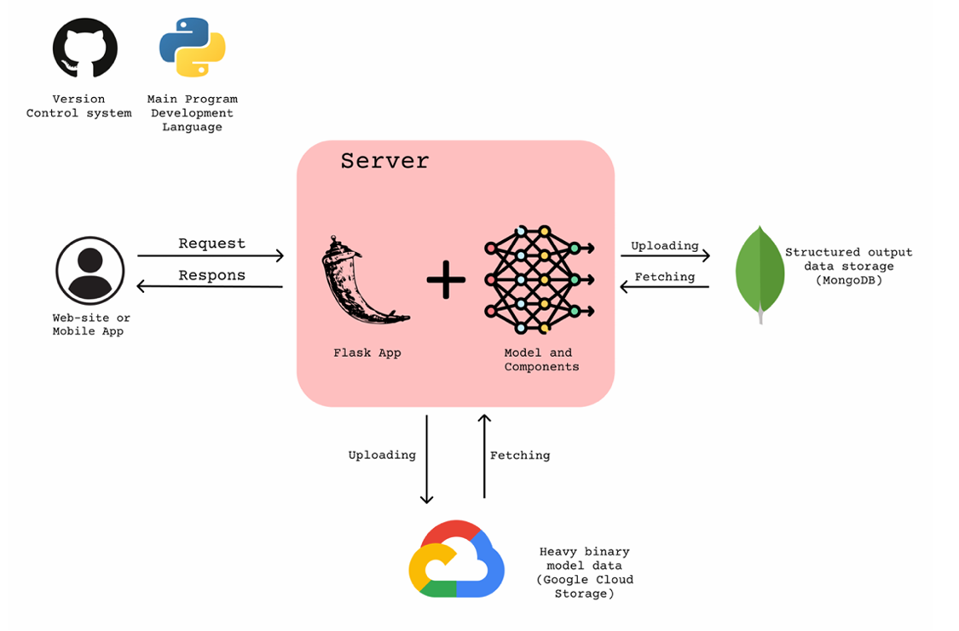
Production Deployment
Web application workflow design
Our server is responsible for both segmentation model and backend site. After the user is authorized he can freely store and fetch all MRI images contained in Google Cloud Storage that he uploaded previously.

Slide 30
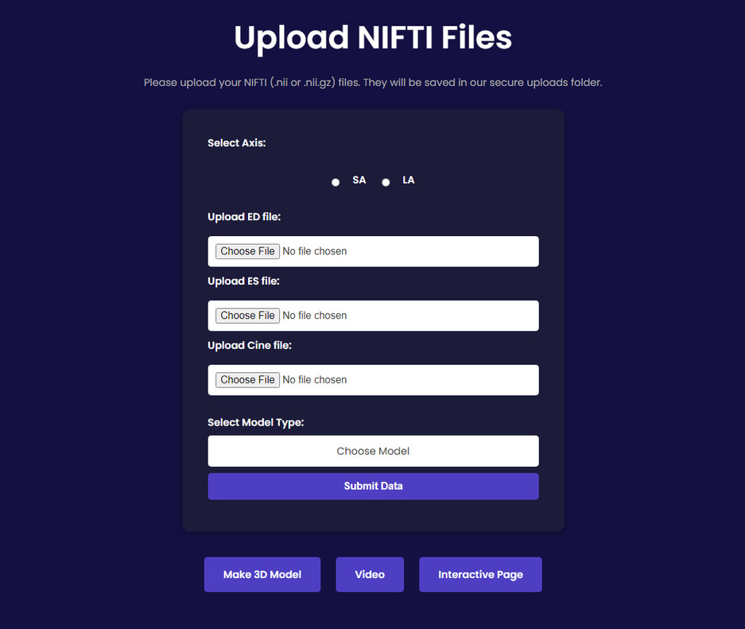
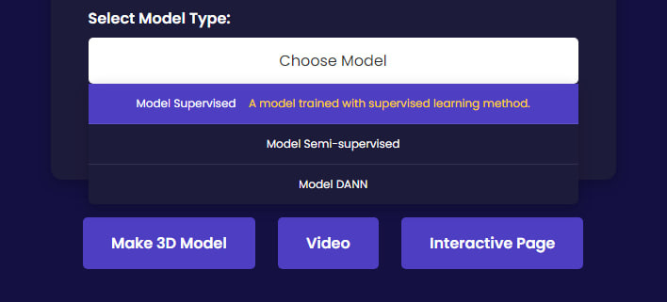
Production Deployment
Upload windows
In the upload window, user should upload ED, ES and Cine files of Cardiac MRI. After that, user can choose which model he wants to use for segmentation.

Slide 31
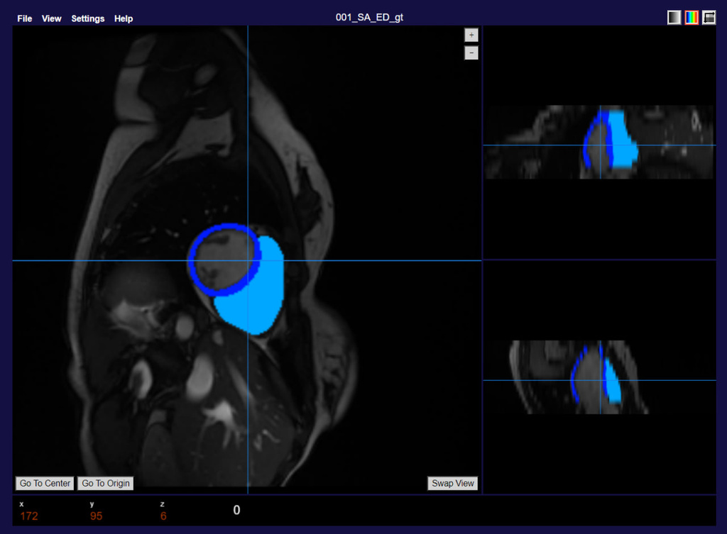
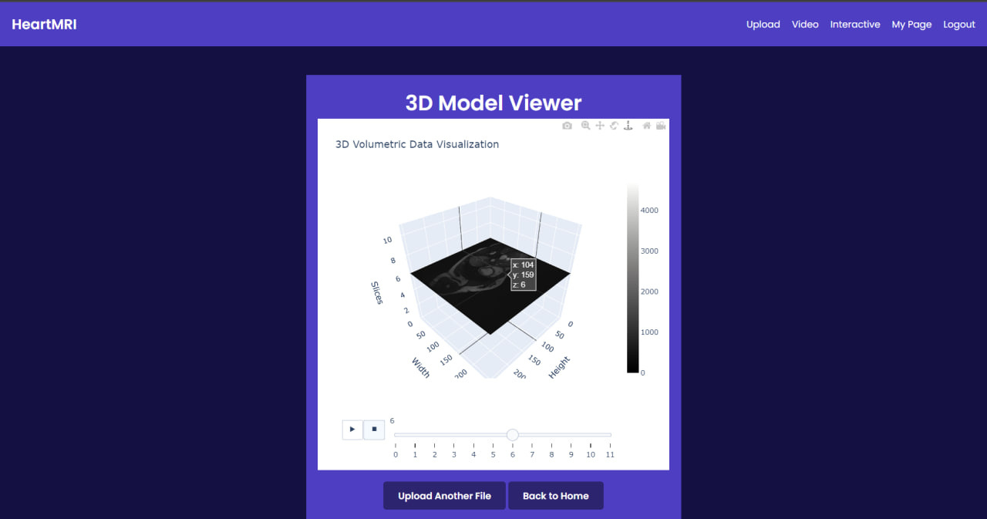
Production Deployment
3D Visualization and Segmentation Inspection tool
After processing MRI images, user can inspect it with tools like rescaling, measuring distance, and changing the colors of separate structures (LV, RV, MYO). Also we included 3D Volumetric Data Visualization feature to inspect multi-sliced MRI data.

Slide 32
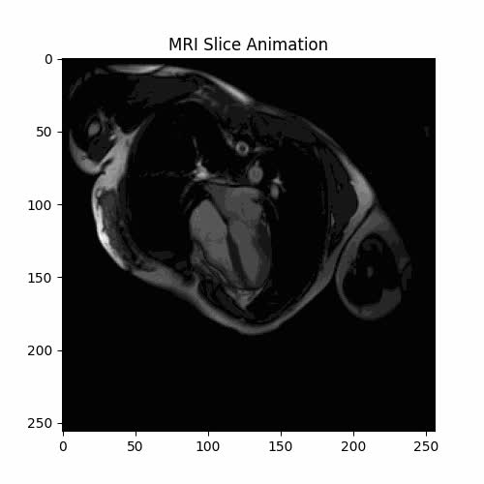
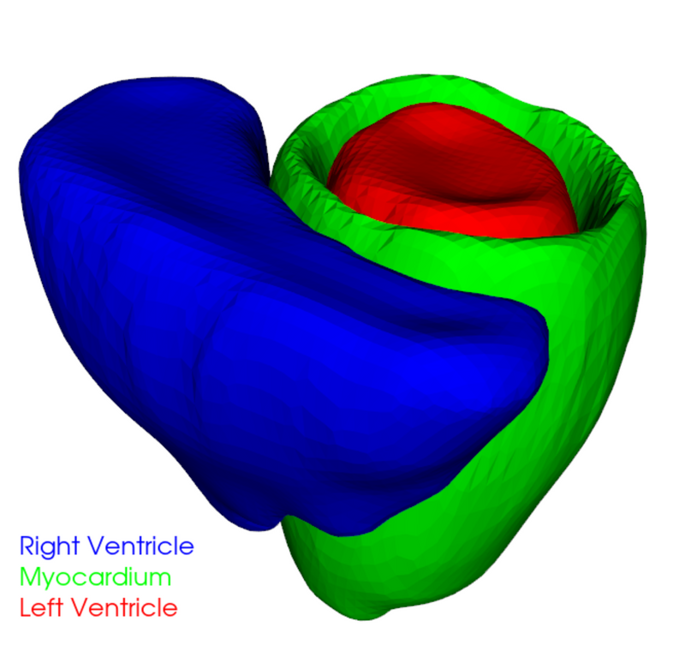
Production Deployment
CINE MRI Animation Generator & 3D Heart Segmentation Viewer
Our model’s segmentation results can be visualized as interactive 3D shapes, allowing users to rotate and zoom in on heart structures like the right ventricle (RV), left ventricle (LV), and myocardium (MYO). Users can also upload CINE MRI scans to create animated videos, offering a dynamic view of cardiac motion.

Slide 33


Conclusion
Results Discussion
This study demonstrated the effectiveness of combining Semi-Supervised Learning with QC Candidate Selection and U-Net-based DANN to improve cardiac MRI segmentation across diverse datasets.
The semi-supervised approach performed well in segmenting the Left Ventricle (LV), Right Ventricle (RV), and Myocardium (MYO)
DANN model excelled in Short Axis (SA) segmentations, especially in terms of Hausdorff Distance. Both models outperformed traditional supervised learning methods in handling diverse datasets.
Overview 03

Slide 34


Conclusion
Future Work
Future work could explore other domain adaptation techniques like CORAL and ADDA, which could further enhance generalization.
Expanding the dataset with more vendor types and clinical centers would also improve model robustness.

